Slide 1
Lake Accotink Preliminary Scope Model
Harold Krivell
GEODESIGN 511

Slide 2
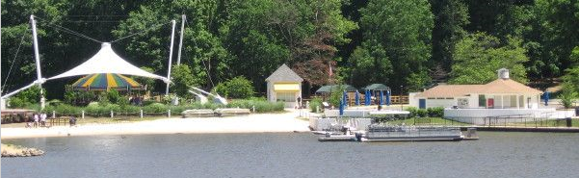
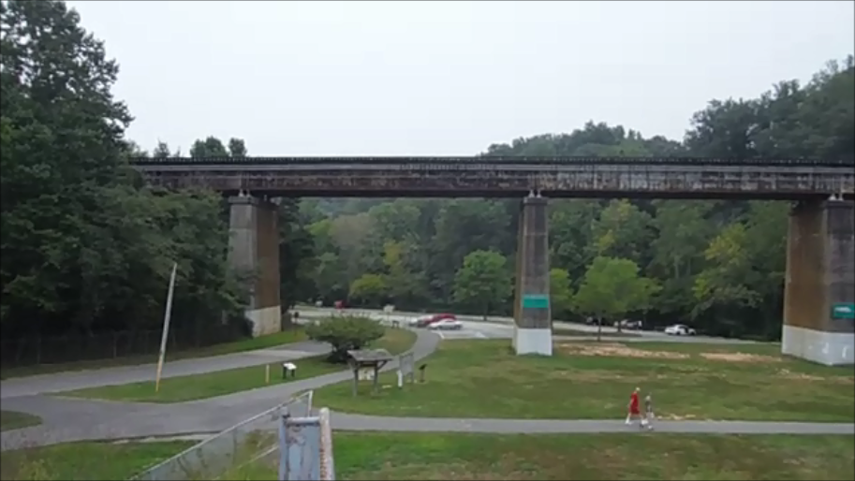
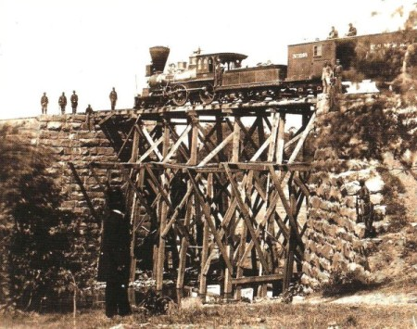
Lake Accotink Overview
(Source: http://arbourrealty.com)
(Source: Harold Krivell)

Slide 3
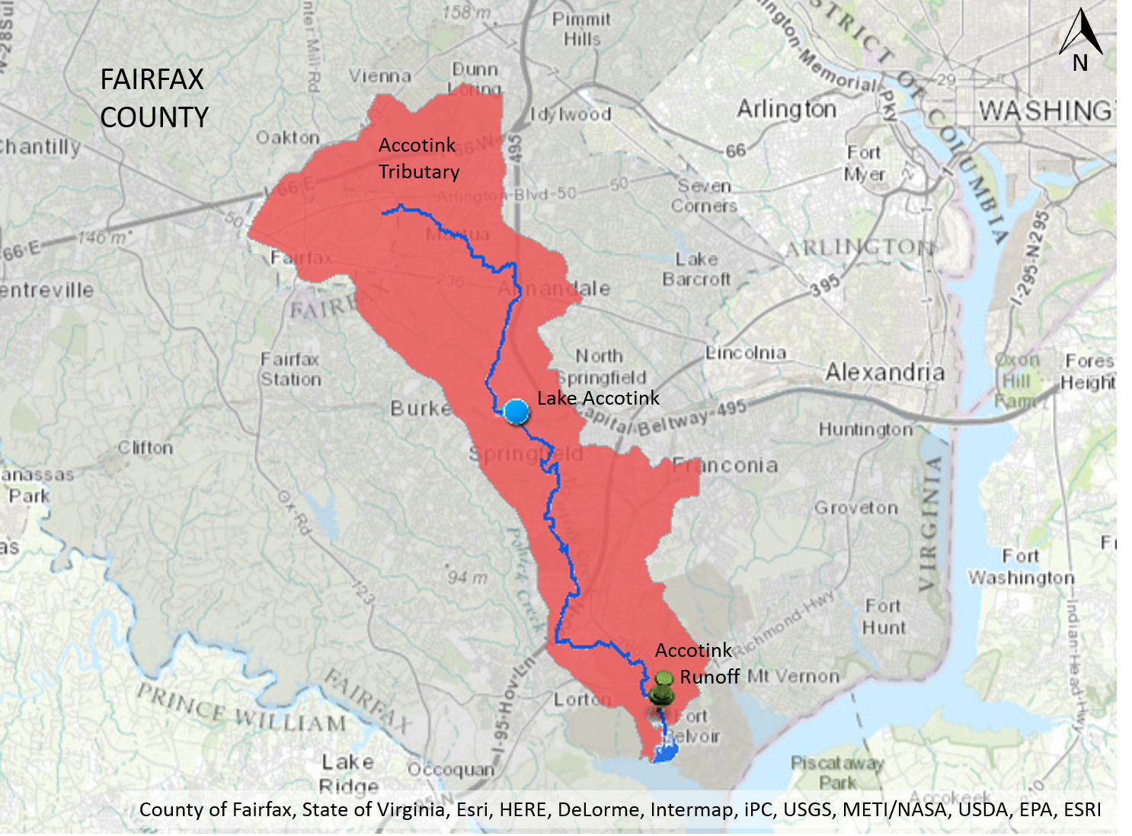
Lake Accotink Overview
Geographic Overview
Lake Accotink is a county park situated in Springfield Virginia, a suburb south of Washington DC.
The Lake is in the center of the Accotink Tributary which drains into the Potomac River.
Various runoff sources along the tributary feed into Accotink Creek which flows from the center of Fairfax county to the Potomac.

Slide 4
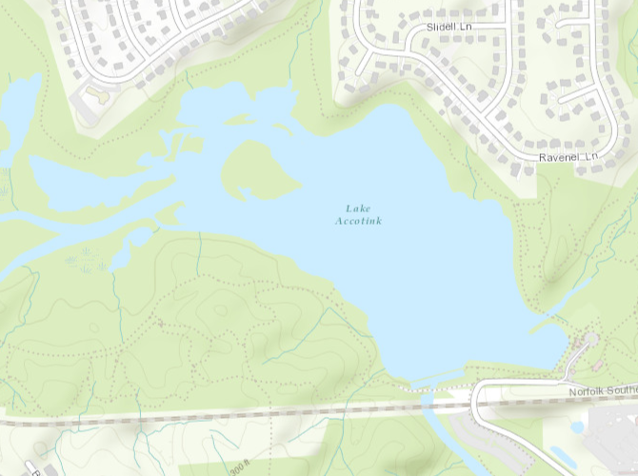
Lake Accotink Overview
Geographic Overview
This is a zoomed view of Lake Accotink and how it is situated with the Ravensworth development to the north.
The map reveals how numerous tributaries and drainage ditches empty into the lake.
(Geographic layout of the park. Source: Harold Krivell, County of Fairfax, State of Virginia, Esri, HERE, DeLorme, Intermap, iPC, USGS, METI/NASA, USDA, EPA.)

Slide 5
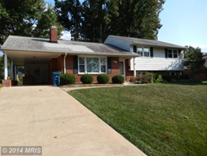
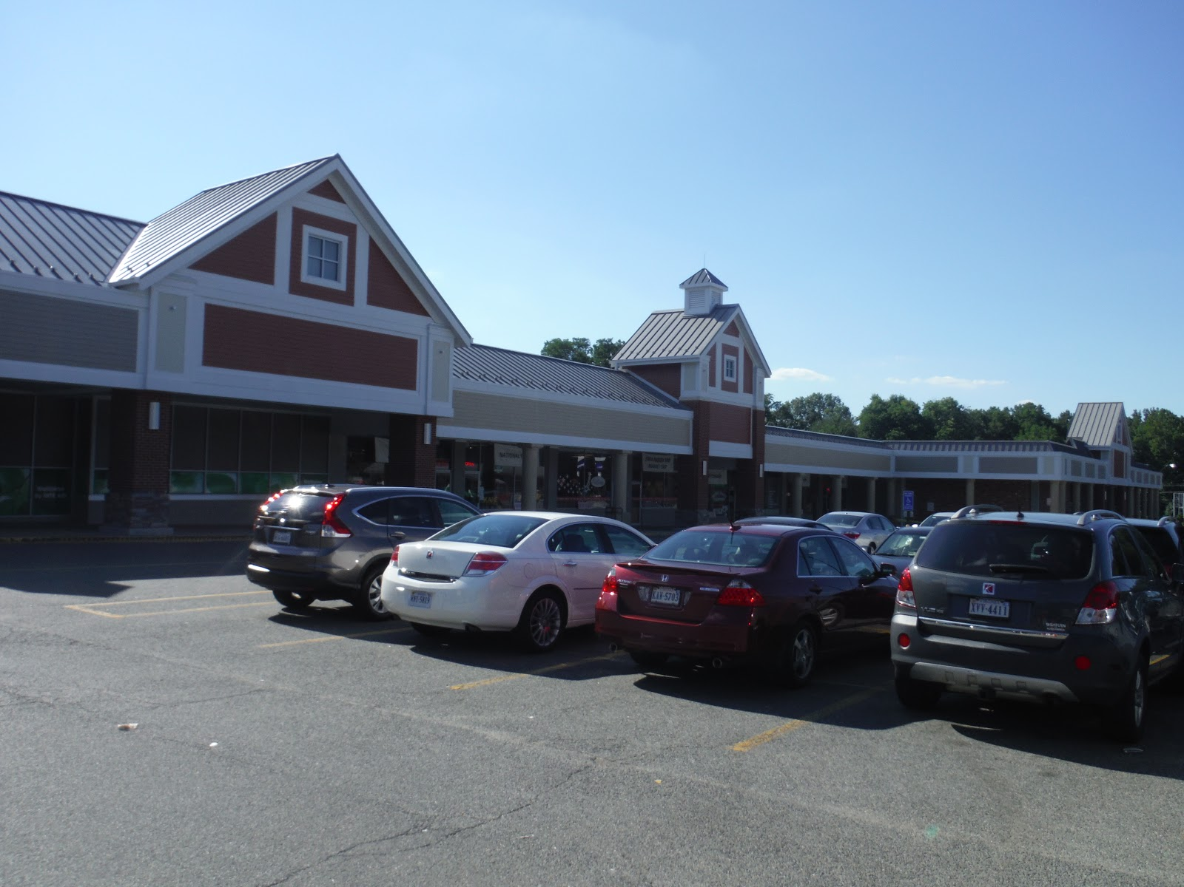
Lake Accotink Overview
Geographic Overview
The Accotink Watershed consists of a mix of residential, commercial and light to medium industrial. View zoning map on next page (Fairfax County DPZ Map).
The county is urbanized and is growing denser with a growing population (Department of Neighborhood and Community Services, p.57).
(Original home in Ravensworth,
Image Source: Redfin.com)
(Ravensworth Shopping Center, Source:
Harold Krivell)

Slide 6
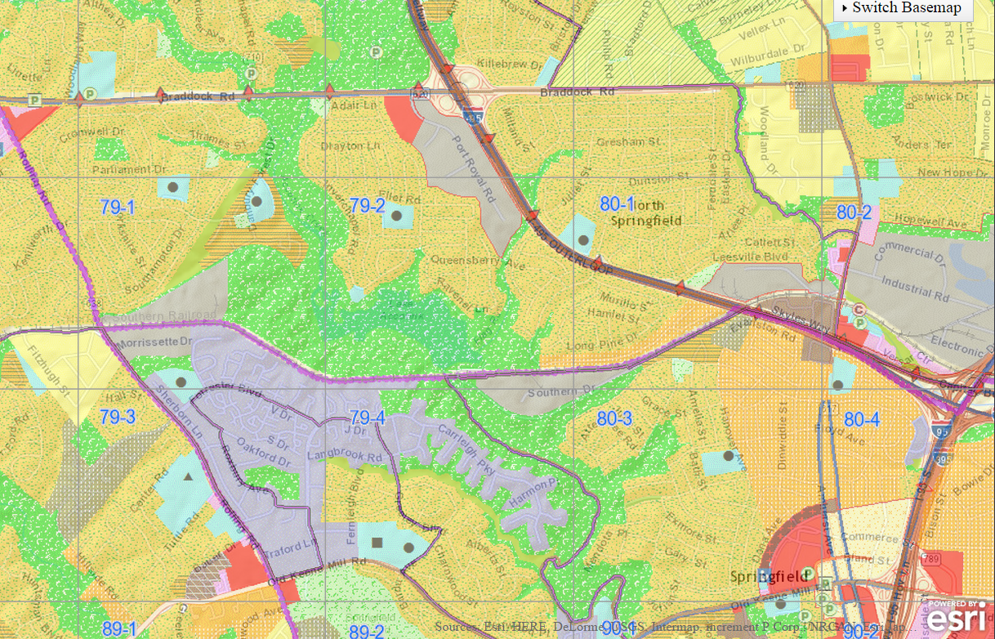
Lake Accotink Overview
Zoning Overview
Zoning shows adjacent industrial zones along the park border and tributaries with a commercial zone attached along Port Royal Road
Map key on next page
Accotink Park
(Fairfax County zoning map. Source: Fairfax County http://www.fairfaxcounty.gov/dpz/comprehensiveplan/interactivemap/compplan_index.htm

Slide 7
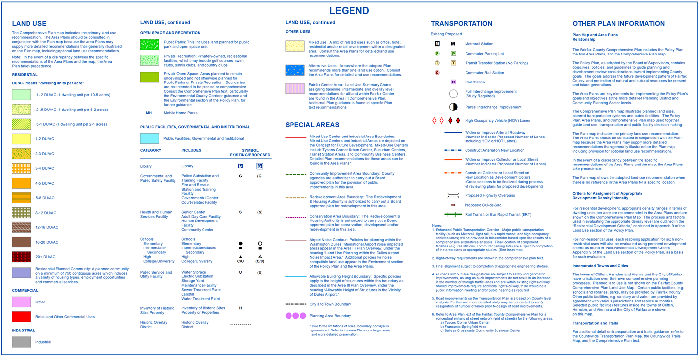
Legend to Previous Map

Slide 8
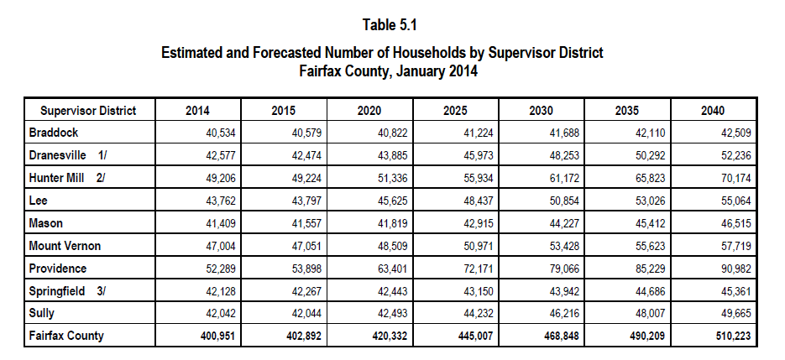
Lake Accotink Overview
Demographic Overview
Table shows a projection of what Fairfax County’s population will be in the next 25 years
A population increase of 107,331 will most likely result in expanded urban infrastructure.
(Table showing Fairfax County population trend. Source: Department of Neighborhood and Community Services Economic, Demographic and Statistical Research p.57)

Slide 9
Lake Accotink Overview
Fairfax Demographic Overview
The residents adjacent to Lake Accotink are middle class suburbanites with a median property value in the range of $350,000 – $549,999 (Department of Neighborhood and Community Services Economic, Demographic and Statistical Research, p.VIII-2).
Most residents are in favor of keeping the lake and enjoy the lake’s recreational amenities (Latasa, 2015).
Most stakeholders would like to see the park’s recreational amenities expanded and trails paved (Latasa, 2015).

Slide 10
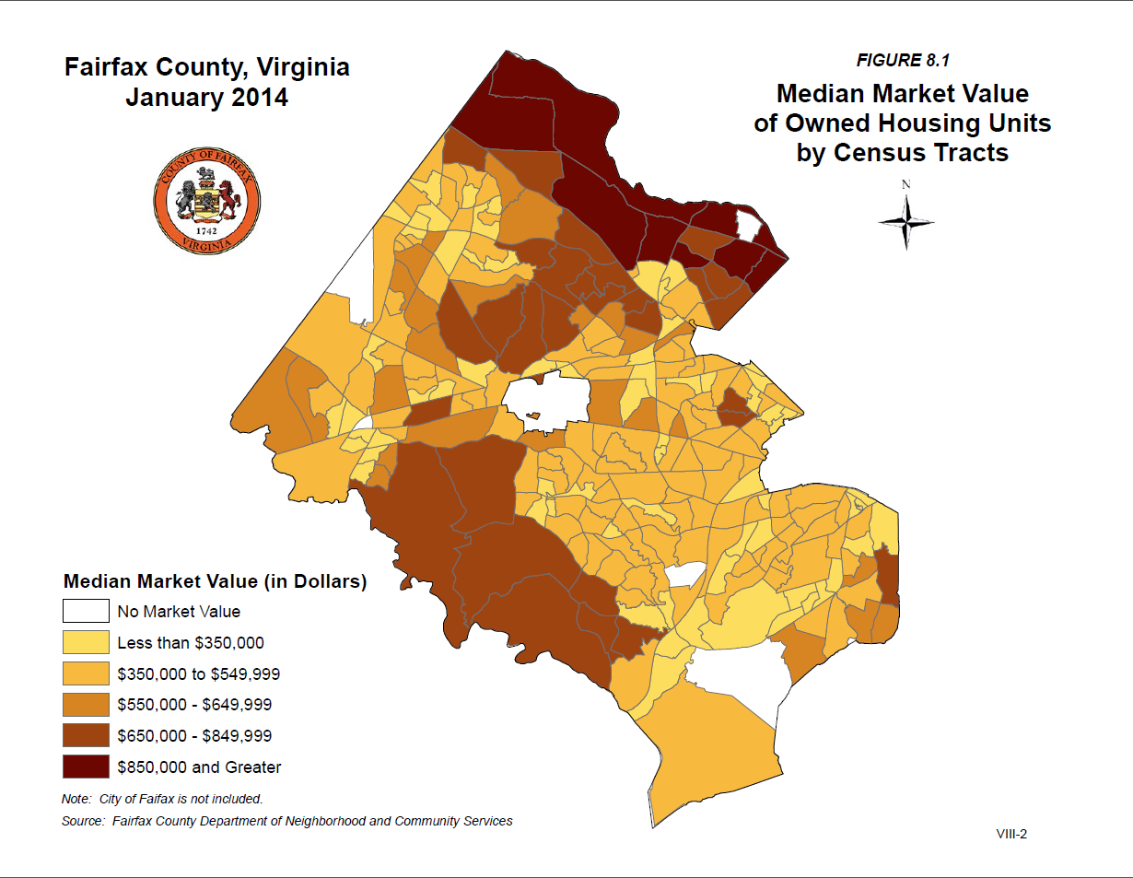
Lake Accotink Overview
Local Stakeholder Overview
The lake is situated residence in the middle of residential homes generally between the $350,000 to $550,000 range, generally middle class for this area of interest.
Lake Accotink

Slide 11
Lake Accotink Overview
Early History
The lake was a water source to the Algonquin Natives during pre colonial and colonial times (Fairfax County Parks).
In 1862 “Confederate General J.E.B. Stuart dispatched twelve men under Gen. Fitzhugh Lee (Robert E. Lee’s nephew) to burn the undefended wooden trestle over Accotink Creek.” (http://www.accotink.org/Trestle_Commemoration_2012.htm)
Historic information can reveal natural processes and how locals interacted with the eco system. This will help during the study phase to reveal trends in the lake’s health and habitat.
(Original Accotink trestle bridge. Source: Friends of Lake Accotink Park http://www.accotink.org/Trestle_Commemoration_2012.htm)

Slide 12
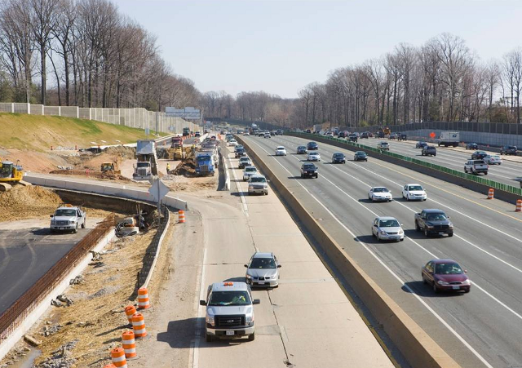
Lake Accotink Overview
Post 1900 history
I-495 was completed in 1964 ^{[6]} and was expanded in 2012 ^{[7]}. Now the expanded surface area on I-495 is greatly contributing to runoff, sedimentation and erosion as larger volumes of water are sent down stream through Flag Run and other tributaries leading to Lake Accotink.
(I-495 Braddock Road interchange near Lake Accotink. Source: Fairfaxnews.com)

Slide 13
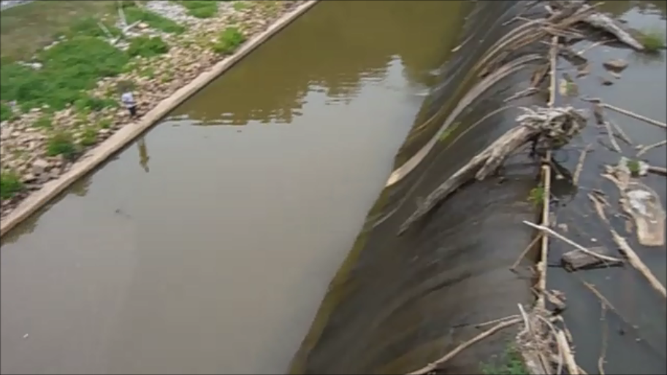
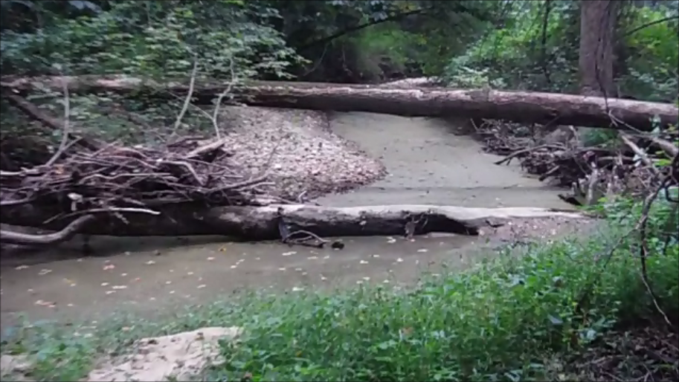
Design Problems with the Lake
One of the main issues the lake is facing is the constant dredging and maintenance costs to do so. Sediment buildup in the lake has become very frequent, however this issue has multiple facets.
(Accotink dam filled with debris. Source: Harold Krivell September 2015)
(Stagnant tributary filled with debris and sediment. Source: Harold Krivell September2015)

Slide 14
Design Problems with the Lake
This web is designed to help understand the problem and find the source of the issue and would fit in the process model of the framework.
For the Lake Accotink issue we begin with the immediate issues facing the lake (highlighted in blue) and work in reverse order, tracing where the problem stems by observing effects up stream.
Logically, this problem diagram works with an upstream flow, however it is possible it may work in a different order with a different problem or set of problems.
Infrastructure Expansion
- I-95 expansion
- Braddock Rd Expansion
-Residential upgrades
-Recreational Paving
Hard Surface Sediment and Pollutant Sources
-Roads, Parking Lots, Residential Driveways, Rooftops and walkways
-Residential fertilizers
Threat to Private Property
Increased runoff plus pollution
Erosion
Threat to flora and fauna
Pollution Transfer
Sediment Flow to Lake
Threat to Park Amenities
Damage to Ecosystem and potential for a dead lake
Increased Park Maintenance Cost
Effects on
Lake Accotink

Slide 15
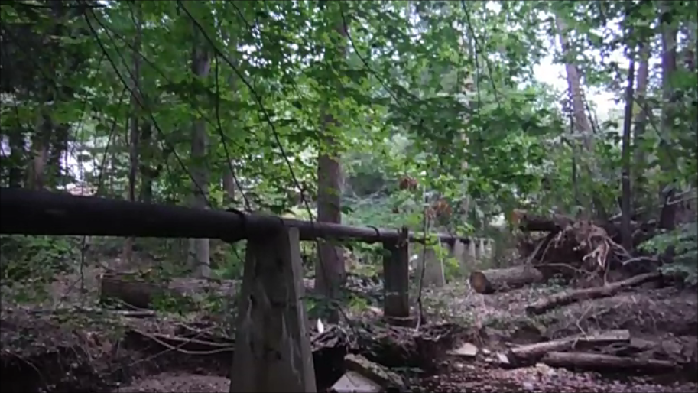
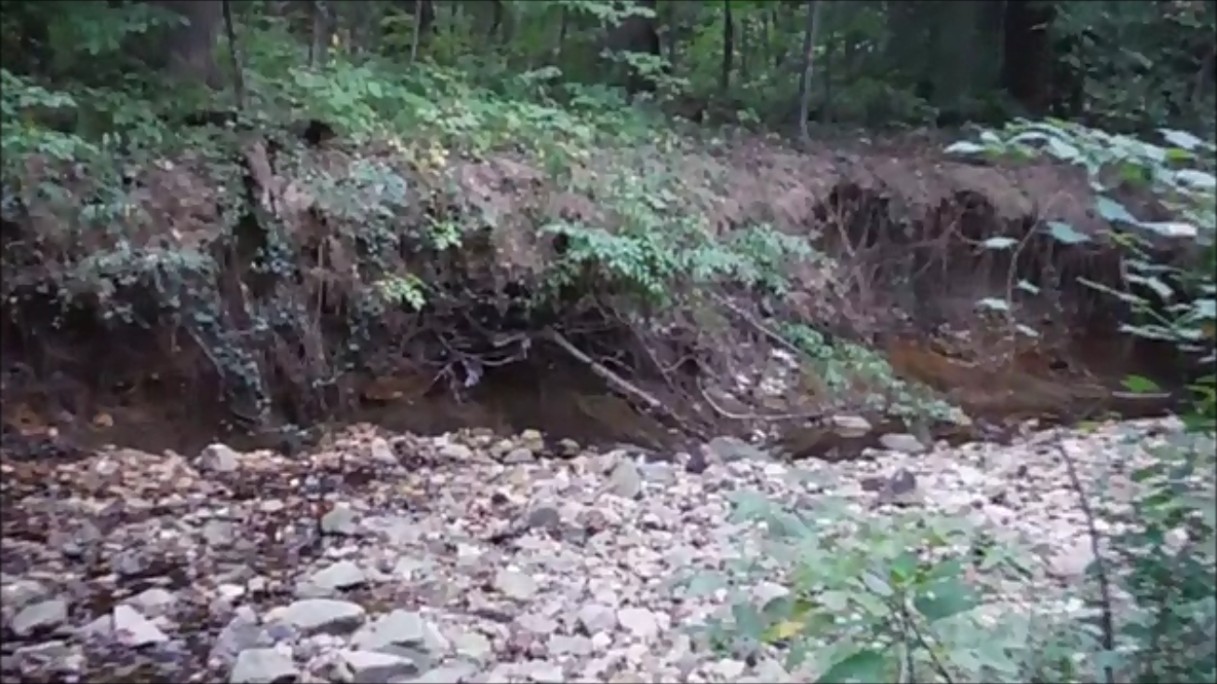
Design Problems with the Lake
Observing up stream effects revealed erosion, sedimentation and pollution. These effects are visible along the banks and tributaries with damaged flora and threat to park and private property and evidence of pollution and sedimentation.
Infrastructure Expansion
- I-95 expansion
- Braddock Rd Expansion
-Residential upgrades
-Recreational Paving
Hard Surface Sediment and Pollutant Sources
-Roads, Parking Lots, Residential Driveways, Rooftops and walkways
-Residential fertilizers
Threat to Private Property
Increased runoff plus pollution
Erosion
Threat to flora and fauna
Pollution Transfer
Sediment Flow to Lake
Threat to Park Amenities
Damage to Ecosystem and potential for a dead lake
Increased Park Maintenance Cost
Effects on
Lake Accotink

Slide 16
Design Problems with the Lake
However the root of the cause reaches up stream to multiple sources. These include…
Road and Parking lots
Driveways, sidewalks and Paved trails
Rooftops and Patios and Walkways
Additional elements of pollution exacerbate the situation…
Expansion of transportation and parking lots, increasing surface runoff
Use of residential Fertilizers
These factors lead to a significant increase in runoff and pollution
Infrastructure Expansion
- I-95 expansion
- Braddock Rd Expansion
-Residential upgrades
-Recreational Paving
Hard Surface Sediment and Pollutant Sources
-Roads, Parking Lots, Residential Driveways, Rooftops and walkways
-Residential fertilizers
Threat to Private Property
Increased runoff plus pollution
Erosion
Threat to flora and fauna
Pollution Transfer
Sediment Flow to Lake
Threat to Park Amenities
Damage to Ecosystem and potential for a dead lake
Increased Park Maintenance Cost
Effects on
Lake Accotink

Slide 17
Offensive Anticipatory Approach
The plan is to approach the problem with an offensive design strategy. The reason for this strategy is because infrastructure elements surrounding the Accotink tributary system is constantly expanding and putting additional stress on the lake and surrounding ecosystem. Leaving the lake to fend for itself will result in the lake filling with sediment which will kill micro-organisms residing at the bottom of the lake. In turn, this will negatively affect the food-chain and starve larger species. In the end the lake will be void of life, making it a dead lake (Latasa et al, personal communication, September 19, 2015). Left untreated, the sediment will continue to flow into the lake, turning the lake into a marsh and killing the fish. This is the least favorable outcome for the stakeholders.

Slide 18
Offensive Anticipatory Approach
The Anticipatory approach will be used although there is already a plan in place for the Flag Run tributary that drains into Lake Accotink (Fairfax County Department of Public Works and Environmental Services, p.5-263). This approach examines an alternate solution the problem using sediment baffles to control sediment and riparian buffers to stabilize banks. Two examples can be used either individually or in a combination.
Sediment Baffles
  Sediment Baffles can be installed at key locations along Accotink Creek and other tributaries to corral sediment and garbage at accessible points so maintenance trucks can easily remove sediment and garbage from the baffled locations. This Should be cheaper than draining and dredging the lake every 5 years or sooner.
  This is a spatially compact solution and can be implemented cheaply and quickly ^{[9]}, however this does and does not address the bank erosion issue.

Slide 19
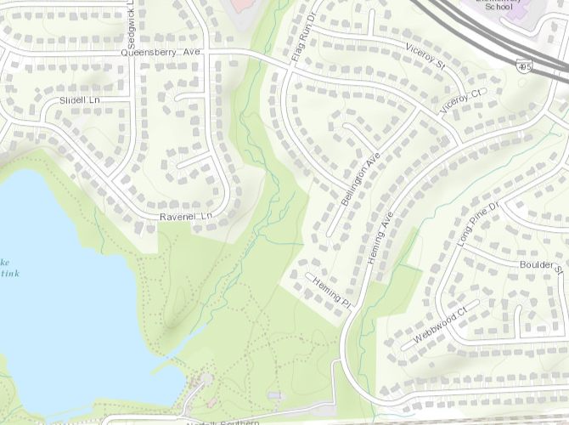
Offensive Anticipatory Approach
Sediment baffles are installed along easy to access locations along the creek.
Maintenance should be cheaper as it does not require draining the lake and maintenance can be carried out any time of the year
The northern most location is accessible from Queensbury Avenue while the Southern location is accessible by park trail
Potential baffle
location
Creek accessible by bridge
Creek accessible by trail
County of Fairfax, State of Virginia, Esri, HERE, DeLorme, Intermap, iPC, USGS, METI/NASA, USDA, EPA

Slide 20
Offensive Anticipatory Approach
Examples of Sediment Baffles
(Source: Pat McClain. Sediment Control Measures and Basin Design. http://www.ncgs.state.nc.us/Documents/Basin%20Design%20WCCC%202012.pdf)

Slide 21
Offensive Anticipatory Approach
Riparian Buffers
  Riparian buffers are Vegetated banks which provide bank stabilization, pollution control and provide habitat (Gilliam, J.W., et al. http://www.soil.ncsu.edu/publications/BMPs/buffer.html).
  I look to using Riparian buffers to address the bank erosion and pollution issue. Also, it will look natural, however, it does not address the upstream sediment from the road runoff.
  The Riparian method is more complicated as it requires constant maintenance, and maintenance becomes more complicated if the buffer lies on private property (Chesapeake Bay Program, p.41).

Slide 22
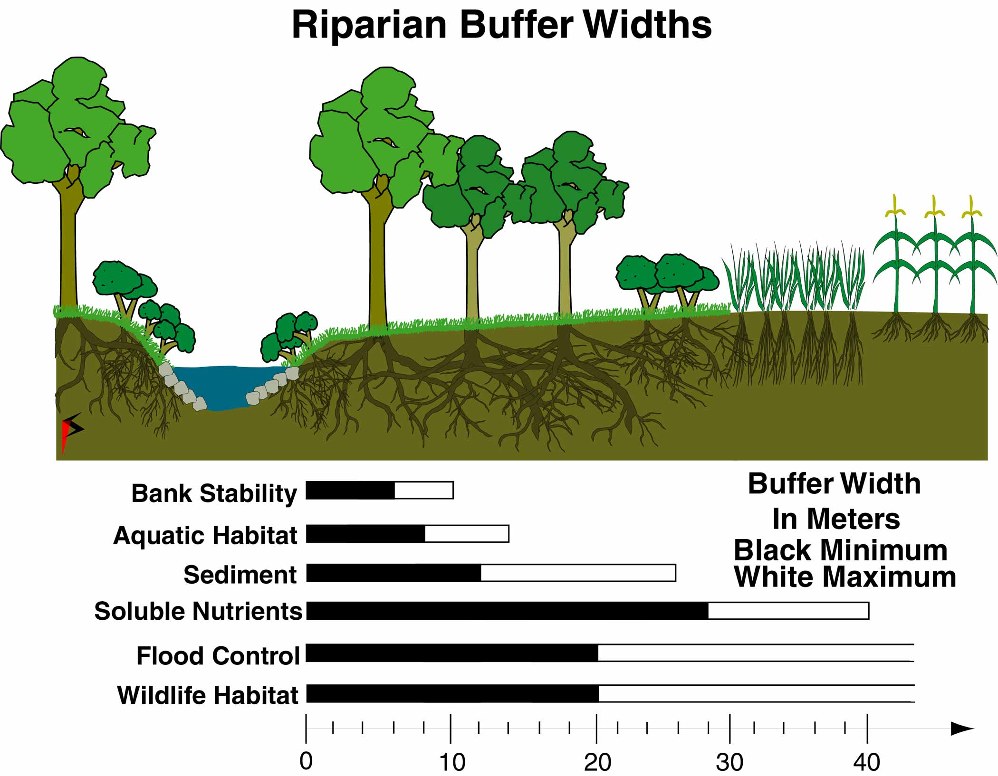
Offensive Anticipatory Approach
Examples of Riparian Buffers
(Riparian buffer diagram (right) Tributary with riparian banks (left) . Source: Chesapeake Bay Program 2006)

Slide 23
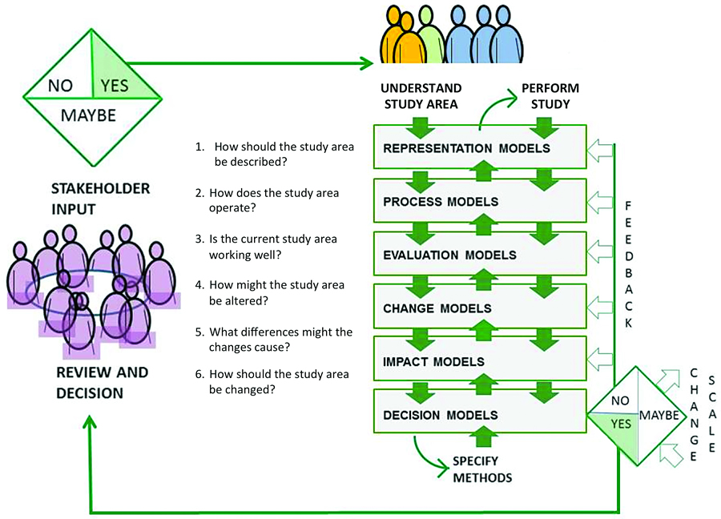
The Geodesign Framework in Action
The Geodesign Framework contributes to the organization of the project from putting together the design team with Design Professionals, Scientists and Technologists^{[4]}, to building a variety models to help represent the outcome of the project. In Lake Accotink’s case, the sequential steps organizes and lays out the following…
Lake Accotink Park Administration
Fairfax County Park Authority
Local residents of the park
Civil Engineers
Fairfax County Park Authority and District Representatives
Cartographers and techs
Ecologists
Hydrologists
Design Team

Slide 24
Stakeholders and Design Team
Stakeholders in this project consist of the following
Lake Accotink Park Administration
  Conduct maintenance and operations of the park
  They would know key locations that need attention
Fairfax County Park Authority
  They have the funding and the plans to preserve the lake
    Local residents of the park- Local residents are able to share how the lake impacts their lives positively and negatively
  Friends of Lake Accotink Park and Neighborhood associations
  Friends of Audrey Moore RECenter (FAMRC)
  Friends of Long Branch Stream Valley (FLBSV)
  Friends of Royal Lake Park (FORL)
  Friends of Rabbit Branch Stream Valley
  Friends of Woodglen Lake

Slide 25
Stakeholders and Design Team
The Design Team will consist of the following
Civil Engineers- Design Professionals
Fairfax County Park Authority and District Representative- Link stakeholders and county resources with team
Cartographers and techs- Collect GIS and elevation data and accurately map key locations for vulnerabilities and ideal locations for construction and present visuals to team and stakeholders.
Ecologists- Identify vulnerable species and locations
Hydrologists- Research hydrodynamics of the tributaries.

Slide 26
The Geodesign Framework in Action
In Lake Accotink’s case, the sequential steps organizes and lays out the following…
Extent of the lake and interactions with community and administration.
The surrounding processes that influence the lake.
Problems with the current design, source of the problem, and where our design is best implemented.
How our design will work best with the surrounding environment, infrastructure and will the method cover all requirements
Stakeholder feedback will encourage refinement of design so the next iteration can or will provide better coverage of requirements.
(Source: Steinitz, C.)

Slide 27
The Geodesign Framework in Action
The Representation Model
Details gathered from the representation process include items such as
Physical geography
Demographic and social geography
History – Both geologic and human history
Stakeholder perceptions and viewpoints
(Source: Steinitz, C.)
Data gathered from this stage defines the Physical Area of interest, how the stakeholders value the lake, and the historic significance and assets of the lake.
Data pertaining to Physical geography is particularly important in the process model as we examine how the hydrography works.

Slide 28
The Geodesign Framework in Action
The Process Model
This step studies the natural forces at play and how the surrounding environment influences the state of the park
Research is performed on the hydro mechanics of the topography and surrounding man-made elements.
Study how are other factors that play into the destruction of the lake. Pollution for example.
If historic data is available, past and present can be compared.
A possible future projection may also be introduced and will contribute to the Impact Model.
(Source: Steinitz, C.)
The completed Process Model will determine how natural and man-made phenomena are making an impact on the lake and if there are any links between the processes. This research will contribute to the Evaluation model.

Slide 29
The Geodesign Framework in Action
The Evaluation Model
This phase will determine if the Lake can handle the influences in the surrounding environment
Ecologists to evaluate wildlife and food chain elements
Environmentalists to study pollution and its origins
Historic data will help evaluate current status
(Source: Steinitz, C.)
Identification of threatened wildlife, erosion and other types of damage in combination with the process model can help identify if the lake can survive on its own or if it needs help. In this case, offensive strategy is required to save the lake as wildlife dies off and the combination of exacerbated natural processes caused by urbanization causes a continuing decline in the lake as well as the area of interest.

Slide 30
The Geodesign Framework in Action
The Change Model
This model will draw all lake data from all parts of the framework to provide a design that satisfies most or all requirements from all parties guided by evaluations of the lake’s ecosystem and rules regarding county construction policy and code.
Constants regarding existing infrastructure, natural hazards and private property will also influence the design.
(Source: Steinitz, C.)
The change models will be presented to stake holders for feedback and review. The process will be reiterated if feedback insists.
The impact model will draw from the decisions made in the change model.

Slide 31
Anticipatory Change Model
Braddock Road, 495,
Private Property
Improve and maintain watershed functions, hydrology, water quality and
habitat.
Involve stakeholders in the protection, maintenance and restoration of County watersheds.
Asbestos and geo hazards
Protect human health, safety, and property by reducing storm water impacts.
Reduce or eliminate sedimentation
Pre Colonial-1960’s
I-495 history
Present
R1
R2
R3
R4
Final Design
Hard- surface runoff
Reinforce banks
Gabion banks
Cement or cinderblock bed lining
Restructure highway drainage
Introduce Riparian Buffers
Build sediment traps at culverts
Build sediment baffles at easy to access locations along the tributary
Prevent property destruction by reinforcing banks.
Sweep roads of debris
Ensure pollution ordnances are followed by local businesses
Rain barrel program
Notify residents about adverse effects of fertilizers and pesticides
Encourage paving using pervious surface material
Urban Expansion
Ecological factors
Rules

Slide 32
The Geodesign Framework in Action
Impact Model
The impact by the design will have some effect on how the lake will look. The riparian buffers should have a positive impact on the eroded areas however the sediment baffle zones may have an irreversible effect since it may require widening portions of the creek to install baffles and
(Source: Steinitz, C.)
Impact Model
The impact by the design will have some effect on how the lake will look. The riparian buffers should have a positive impact on the eroded areas however the sediment baffle zones may have an irreversible effect since it may require widening portions of the creek to install baffles and

Slide 33
The Geodesign Framework in Action
Decision model and feedback
This phase will decide if the baffle and riparian buffer design is right for the area.
Research and change model will be presented to the stakeholders. A “NO” answer option will take us back to previous parts of the framework for review or reconsideration for the design.
A “MAYBE” decision will encourage the team to change the scale beyond the Accotink Tributaries.
(Source: Steinitz, C.)
A “YES” decision will be reached if the Riparian Buffer and Baffle plans are agreed upon and the changes to environment are understood by stake holders. This will be a signal for the project to go ahead.

Slide 34
References
^{[1]} “Lake Accotink Dam, circa 1918,”. braddockheritage.org/, accessed: October 2, 2015, http://braddockheritage.org
^{[2]} Lewis, P. F. (1982). Axioms for Reading the Landscape. Schlereth, Thomas J. (ed.) Material Culture Studies in America. (pp.175-182). Nashville: American Association for State and Local History
^{[3]} Steinitz, Carl. (2012). A Framework for Geodesign. Redlands, CA. ESRI Press.
^{[4]} Friends of Lake Accotink Park. (2015). Retrieved September 19, 2015, from http://www.accotink.org/FLAP/
^{[5]} Express Lanes Development. (2015). Retrieved September 18, 2015, from https://www.expresslanes.com/project-background
^{[6]} Kozel, S. (1997-2007). Roads to the Future: Capital Beltway. Retrieved September 18, 2015, from http://www.roadstothefuture.com/Capital_Beltway.html
^{[7]} Latasa (et al.), P. (2015). Meeting with Friends of Lake Accotink Park and Park managers. September 19, 2015.

Slide 35
References
^{[8]} McLaughlin, R. (Accessed 2015). Using Baffles to Improve Sediment Basins. Soil Facts. Retrieved from http://content.ces.ncsu.edu/20181.pdf
^{[9]} Chesapeake Bay Program. (2006). Best Management Practices for Sediment Control and Water Clarity Enhancement. Annapolis, Maryland.
^{[10]} Gilliam, J.W., D.L. Osmond, and R.O. Evans. 1997. Selected Agricultural Best Management Practices to Control Nitrogen in the Neuse River Basin. North Carolina Agricultural Research Service Technical Bulletin 311, North Carolina State University, Raleigh, Retrieved from: http://www.soil.ncsu.edu/publications/BMPs/
^{[11]} Marion, M., & Lipsey, M. (2007). Braddock’s True Gold: 20th- Century Life in the Heart of Fairfax County. Fairfax, VA. County of Fairfax.
^{[12]} Department of Neighborhood and Community Services Economic, Demographic and Statistical Research. (2014). Demographic Reports 2014 County of Fairfax, Virginia. Fairfax, Virginia: www.fairfaxcounty.gov/government/about/data

